Slide 1

Politecnico di Milano A.A. 2015-2016 Software Engineering 2 project: Code Inspection
Alessandro Pozzi (matr. 852358), Marco Romani (matr. 852361)

Slide 2
Assigned classes
Main class:
InterceptorManager (appserver/ejb/ejb-container/src/main/java/com/sun/ejb/ containers/interceptors/InterceptorManager.java)
Internal classes:
AroundInvokeInterceptor
BeanAroundInvokeInterceptor
CallbackInterceptor

Slide 3
But what do these classes do?

Slide 4
InterceptorManager loads and manages the interceptors in a java EE container.
Interceptors :
auxiliary components “attached” to bean classes (or single methods).
intercept method calls or lifecycle events on the target bean class in order to execute some kind of pre/post-processing.
follow the lifecycle of the target class’ instance.

Slide 5
AroundInvokeInterceptor
pre-processing
intercept()
Target bean instance
Method call

Slide 6
CallbackInterceptor
pre/post- processing
intercept()
Lifecycle event (i.e. creation)
target bean instance

Slide 7
Assigned methods
load2xLifecycleMethods( ArrayList < CallbackInterceptor > [ ] metaArray )
called to load interceptors that act accordingly to old 2.x versions of the EJB standard.
loadOnlyEjbCreateMethod( ArrayList < CallbackInterceptor > [ ] metaArray , int numPostConstructFrameworkCallbacks )
called to load only interceptors for “ejbCreate” methods in case of a component that does not have a @PostConstruct annotation or does not even implement the EnterpriseBean interface.

Slide 8
Assigned methods
AroundInvokeInterceptor( int index , Method method )
CallbackInterceptor( int index , Method method )
intercept( final InterceptorManager . AroundInvokeContext invCtx ) in AroundInvokeInterceptor class
intercept( final InterceptorManager . AroundInvokeContext invCtx ) in BeanAroundInvokeInterceptor class

Slide 9
Now let’s move to the checklist!

Slide 10
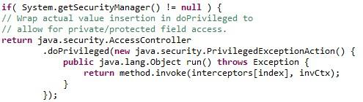

Indention
intercept in AroundInvoke
Interceptor
CallBackInterceptor

Slide 11
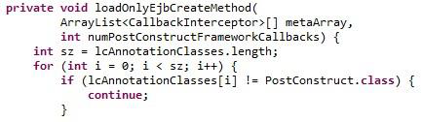

File Organization
separator blank line suggested
unnecessary
blank lines

Slide 12



Wrapping lines
bad line breaks

Slide 13
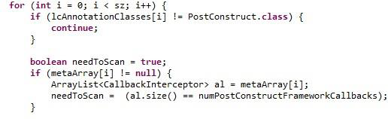
Initialization and declaration
declaration not at the
beginning of the block

Slide 14
Comments
There are almost no comments!
The few comments are simply notes for the developer himself.
Complete lack of documentation!

Slide 15
Java source file
One public class (InterceptorManager) and two public interfaces (AroundInvokeContext and InterceptorChain) within the same source file.
Almost all public methods and interfaces do not have any documentation.
The very few lines of javadoc are almost useless.

Slide 16
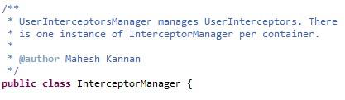
Thank you!

Slide 17
Arrays
There is no check on the “index of-out-bound” type of errors, like in the load2xLifecyclesMethods:
“i” maximum value, “sz”, depends on the lcAnnotationClasses length, which is an attribute of the InterceptorManager, initialized by the constructor…
This “i” variable is used to access in the pre30LCMethodsNames and metaArray arrays…
Hard to tell if it will go out-of-bounds!
There are no guarantees!

Slide 18
Exceptions
In Load2xLifecycleMethods, noSuchMethodException is not handled
Also, beanClass.getMethod can raise a SecurityException that may be relevant to catch.

Slide 19
Exceptions
In AroundInvokeInterceptor , it might be better to catch more specific exceptions:
Only the general Exception is caught

Slide 20
Duplicates
There are many duplicates and very similar parts of code in our classes!

Slide 21
The methods load2xLifecycleMethods and loadOnlyEjbCreateMethod can be refactored using a common method:

Slide 22
Duplicates
Let’s see the class diagram of the InterceptorManager java source file:

Slide 23
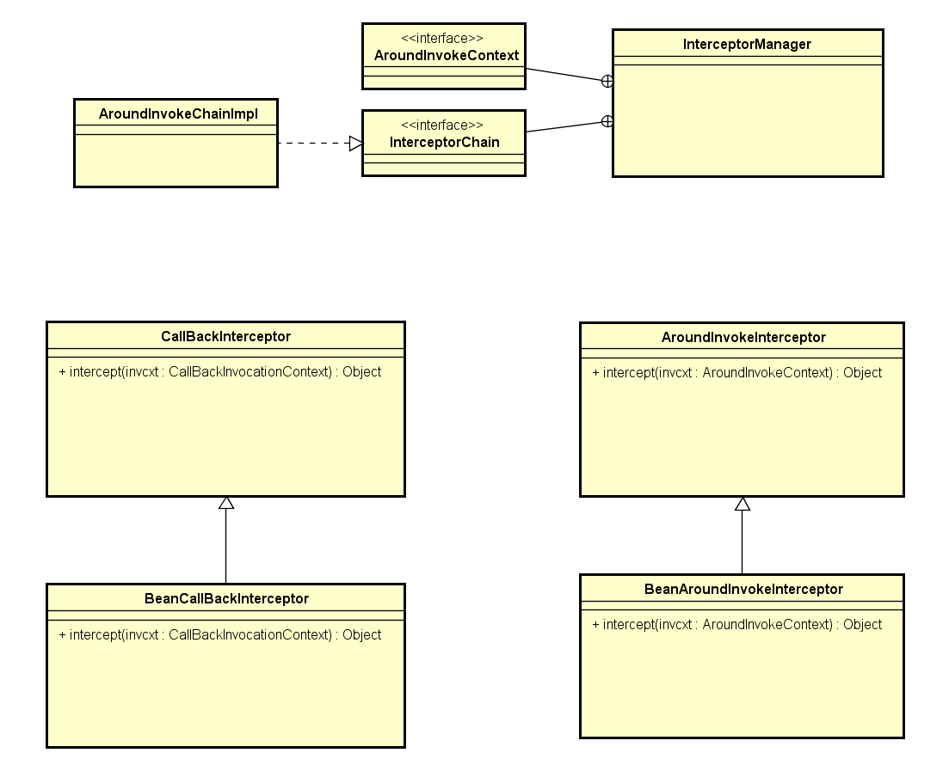
Main Public Class of the java file
Other (non Public) classes in this java file

Slide 24
Very similar classes!

Slide 25
AroundInvokeInterceptor
CallbackInterceptor
They have the the same constructor!

Slide 26
AroundInvokeInterceptor
CallbackInterceptor
Their only method, intercept, is very similar!
The only difference is argument of the method…
…on which, anyway, the same operations are done!

Slide 27
Even their subclasses are very similar!

Slide 28
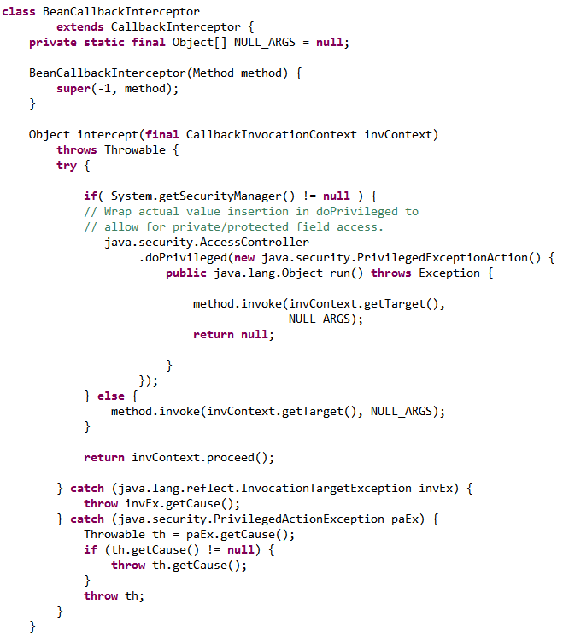
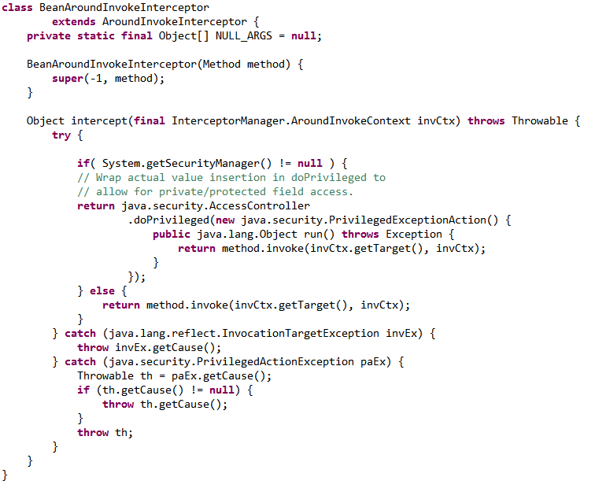
BeanAroundInvokeInterceptor
BeanCallbackInterceptor

Slide 29
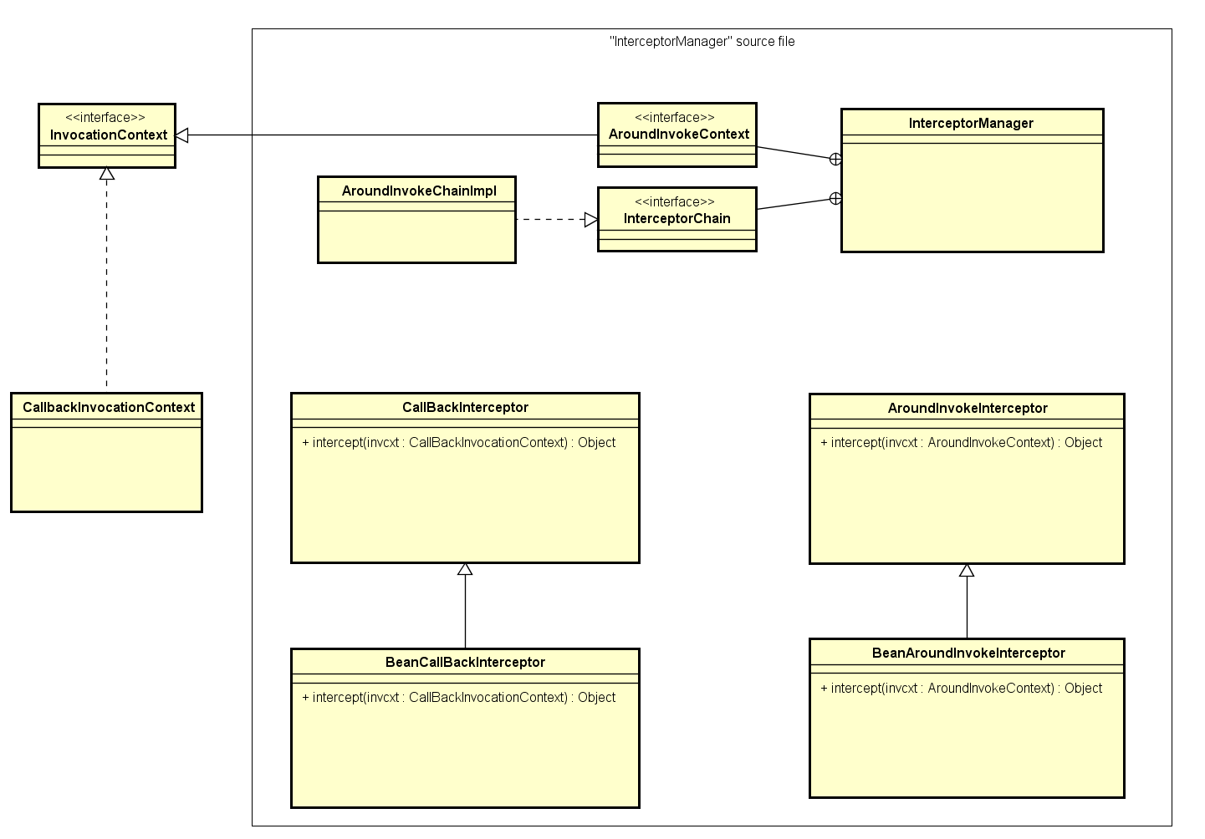
These method’s arguments are the real difference between the two classes

Slide 30
The class hierarchy should be reorganized so that CallbackInterceptor and AroundInvokeInterceptor inherits from a common class, which have the intercept(InvocationContext) method.

Slide 31
Thank you for your attention!
Questions?

